Slide 1
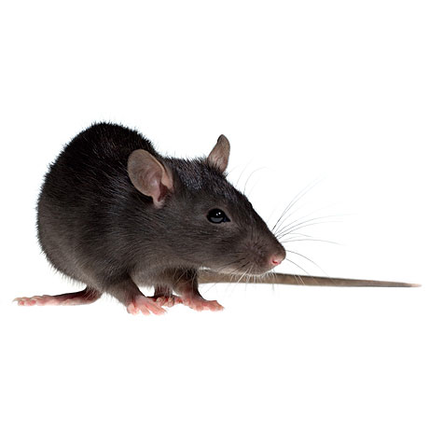
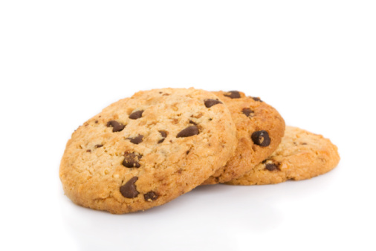
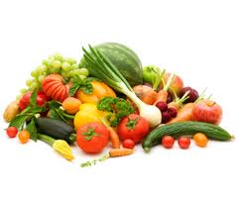
Tasty food
Normal food
Internal state
Figure 2
Trial
Simulation specifications:
average over 2000 runs
algorithm: Q-learning + softmax
alpha = 0.25
beta = 50
gamma = 0.8
m = 2
n = 4
initial internal state = -50
optimal internal state = -5
food outcome = 4
energy expenditure per step = 1
Taste-Induced Reward = 0 or 100

